Slide 1
Clinical Graphs using SAS®
Sanjay Matange, Director in R&D, SAS Institute Inc.

Slide 2
Presenter
Sanjay Matange, Director in R&D, SAS Institute Inc.
Sanjay Matange is R & D Director in the Data Visualization Division at SAS, responsible for the development and support of ODS and ODS Graphics, including Graph Template Language (GTL) and Statistical Graphics (SG) procedures.
Sanjay has been with SAS for over 25 years, is co-author of three patents, author of four SAS Press books and author of Graphically Speaking, a blog on data visualization.

Slide 3
A Brief History
ODS Graphics is the new way of creating graphs in SAS.
ODS Graphics was first released in SAS 9.2 to create automatic graphs from SAS procedures.
The software continues to be enhanced to make all Graphs easier.
This paper presents ways to create Clinical Graphs using SAS 9.4 SGPLOT and SGPANEL procedures.

Slide 4
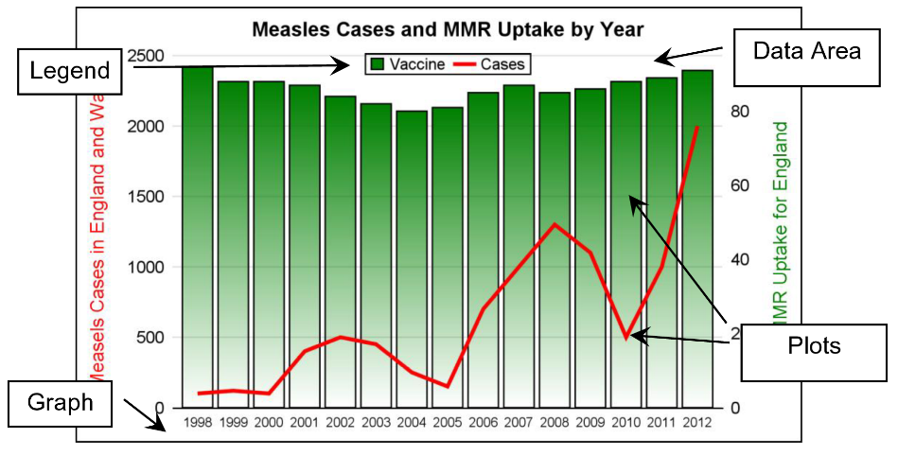
Structure of a Graph
The SGPLOT graph has the following features:
Zero or more titles.
Zero or more footnotes.
One region in the middle that is used to display the data.
One or more plots that are used to display the data.
A set of axes that are shared by the plots in the cell.
Zero or more legends.
Zero or more insets.
In this graph note the axis labels are colored to match the data they represent.

Slide 5
Plot Statements
Plot Groups
Basic Plots: Such as scatter, series, and so on.
Fit and Confidence Plots: Such as regression and loess plots.
Distribution plots: Such as histograms and box plots.
Categorical Plots: Such as bar charts and dot plots.
Other: Reference line, Inset, Legend, etc.
SG procedure uses the process of combining compatible plot statements in layers to create the final graph.

Slide 6
Plot Statements
Plot Combinations
Basic and Fit plots can be combined with each other and “Other” plots.
Distribution plots can only be combined with other plots in same group and “Other” plots.
Categorical plots can only be combined with other plots in same group and “Other” plots.
Now let us review how to create some popular clinical graphs using SAS 9.4 features

Slide 7
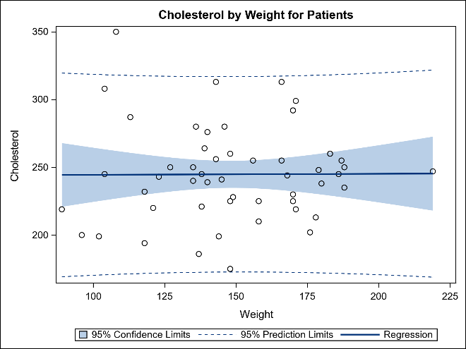
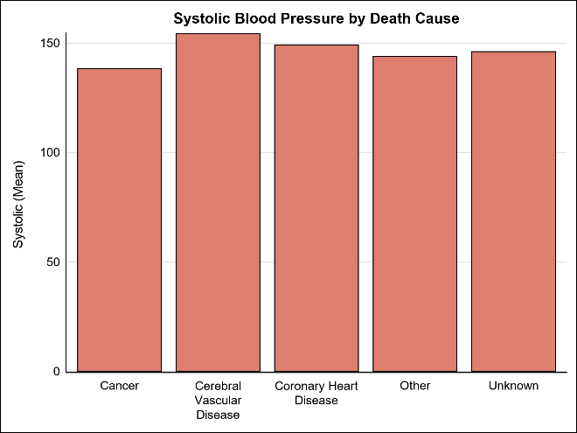
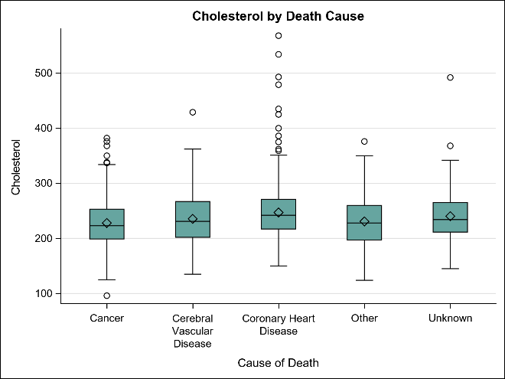
Simple Graphs
Many graphs need only one plot statement.
Regression plot
Bar chart
Box plot
proc sgplot data=sashelp.heart;
reg x=weight y=cholesterol / cli clm;
run;
proc sgplot data=sashelp.heart;
vbar deathcause / response=systolic;
run;
proc sgplot data=sashelp.heart;
vbox cholesterol / category=deathcause;
run;

Slide 8
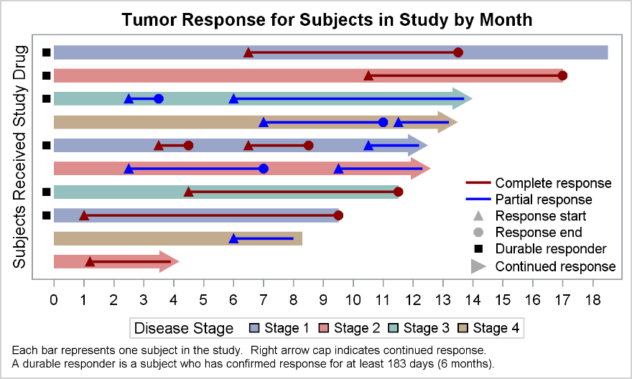
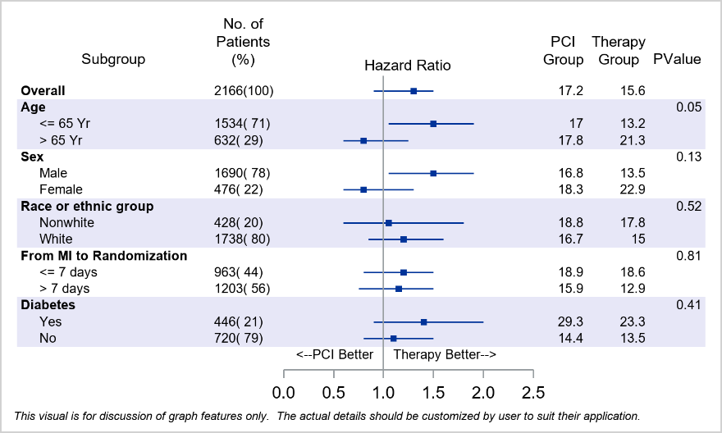
Complex Graphs
Complex clinical graphs can be made by layering plot statements.
Swimmer Plot
Subgrouped Forest Plot
Let us review how to create such clinical graphs.

Slide 9
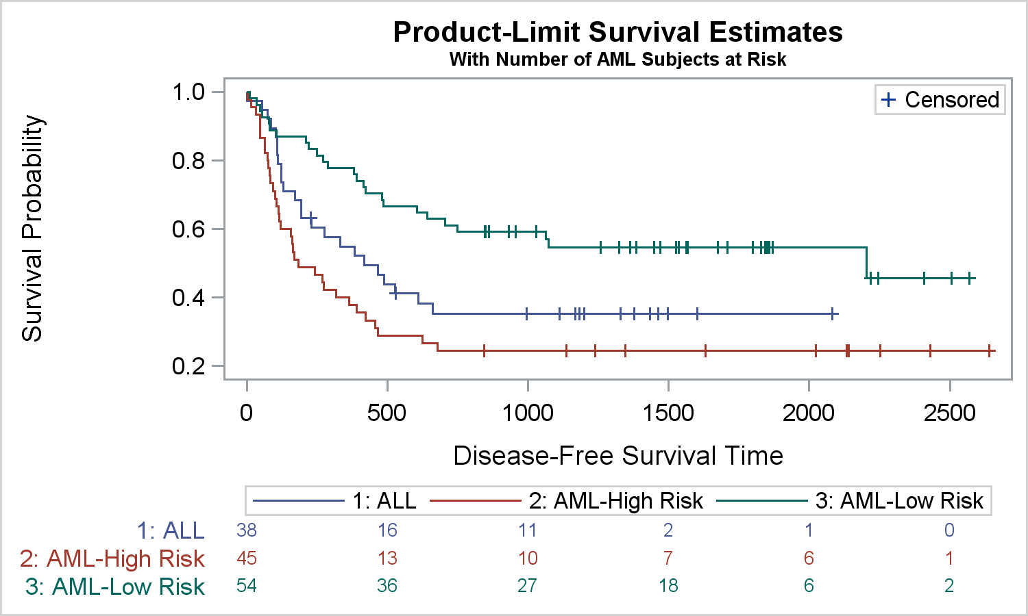
Survival Plot
The Product-Limit Survival Estimates plot displays the survival probabilities by stratum over time.
This plot displays the number of subjects in the study by stratum over time along the bottom of the graph.
This graph is created automatically by the LIFETEST Procedure. Let us see how it can be built using SGPLOT.

Slide 10
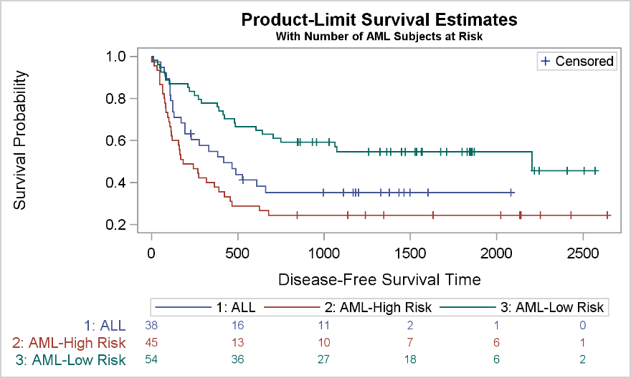
Survival Plot
The data for the procedure is saved from PROC LIFETEST using ODS Output.
title 'Product-Limit Survival Estimates';
title2 h=0.8 'With Number of AML Subjects ...';
proc sgplot data=SurvivalPlotData;
step x=time y=survival / group=stratum name='s';
scatter x=time y=censored / name='c';
scatter x=time y=censored / group;
xaxistable atrisk / x=tatrisk
class=stratum colorgroup=stratum;
keylegend 'c' / location=inside;
keylegend 's';
run;
The Axis Table makes it easy to display of the number of subjects at risk at the bottom of the graph.

Slide 11
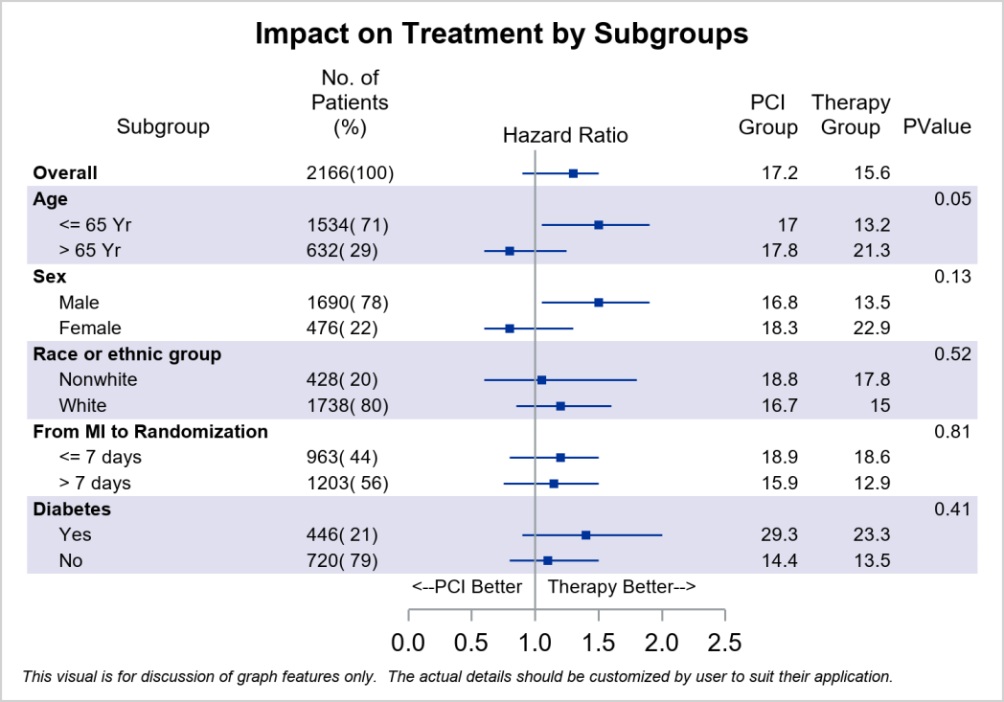
Subgrouped Forest Plot
A Forest plot is used for meta-analysis of the results of randomized controlled trials.
This plot has a graphical display of Hazard Ratio along with other statistics for the study by subgroups.
Let us see how it is built using SGPLOT.

Slide 12
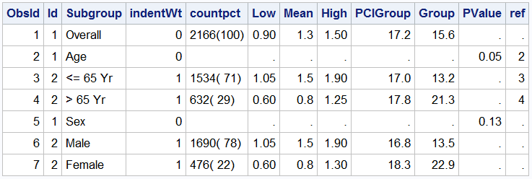
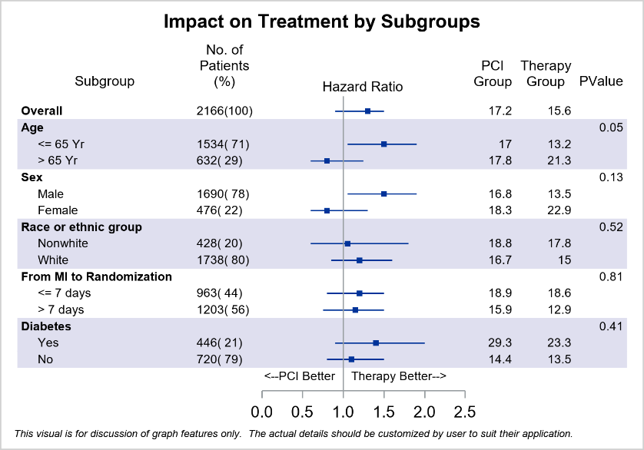
Subgrouped Forest Plot
Here is the data set we have used to create this graph.

Slide 13
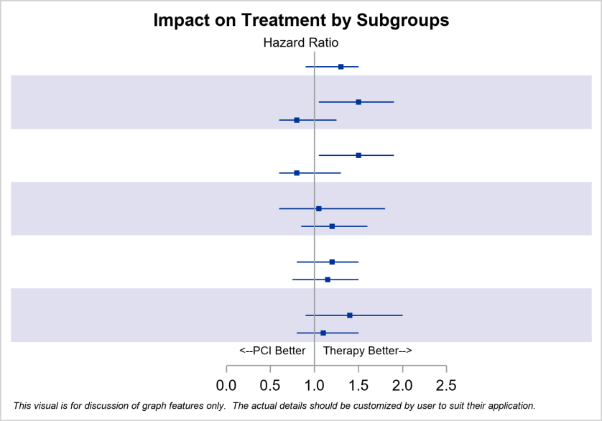
Subgrouped Forest Plot
First we display the graphical Hazard Ratio information by Study
title 'Impact on Treatment by Subgroups';
proc sgplot data=forest_subgroup_2;
styleattrs axisextent=data;
refline ref / discretethickness=1 <options>;
highlow y=obsid low=low high=high;
scatter y=obsid x=mean / <options>;
scatter y=obsid x=mean / y2axis <options>;
refline 1 / axis=x;
text x=xl y=obsid text=text / <options>;
yaxis reverse display=none;
xaxis display=(nolabel) <options>;
x2axis label='Hazard Ratio‘ / <options>;
run;
The 2nd scatter plot on y2axis creates the upper x-axis.

Slide 14
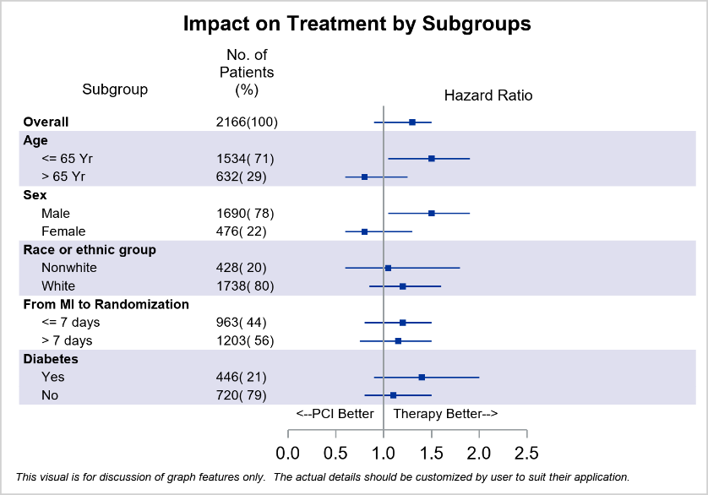
Subgrouped Forest Plot
Next, we add the display of the two data columns on the left.
title 'Impact on Treatment by Subgroups';
proc sgplot data=forest_subgroup_2;
styleattrs axisextent=data;
refline ref / <options>;
highlow y=obsid low=low high=high;
scatter y=obsid x=mean / <options>;
scatter y=obsid x=mean / <options>;
refline 1 / axis=x;
text x=xl y=obsid text=text / <options>;
yaxistable subgroup / position=left <options>
yaxistable countpct / position=left <options>;
yaxis reverse display=none;
xaxis display=(nolabel) <options>;
x2axis label='Hazard Ratio‘ / <options>;
run;
The first YAxisTable uses INDENTWEIGHT and TEXTGROUP options.

Slide 15
Subgrouped Forest Plot
Then, we add the display of the three data columns on the right
proc sgplot data=forest_subgroup_2;
styleattrs axisextent=data;
refline ref / <options>;
highlow y=obsid low=low high=high;
scatter y=obsid x=mean / <options>;
scatter y=obsid x=mean / <options>;
refline 1 / axis=x;
text x=xl y=obsid text=text / <options>;
yaxistable subgroup / <options>;
yaxistable countpct / <options>;
yaxistable PCIGrp group pval / position=right;
yaxis reverse display=none;
run;
The YAxisTable on the right includes three variables.

Slide 16
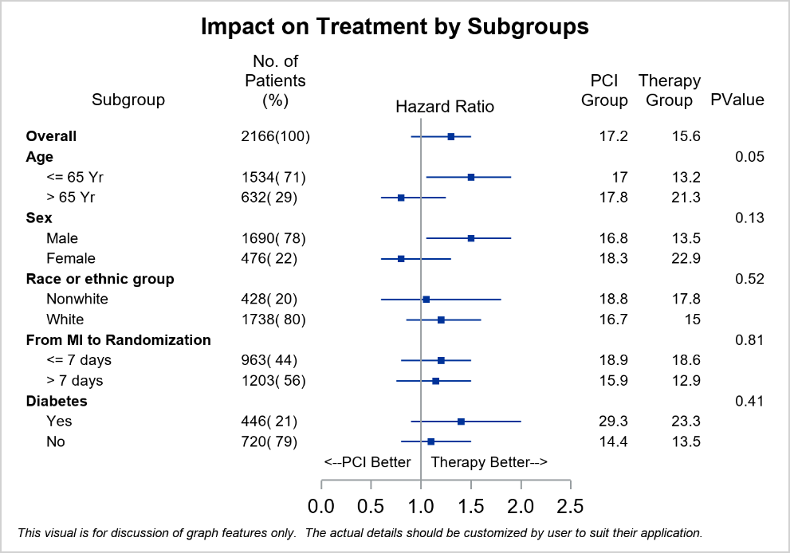

Subgrouped Forest Plot
Horizontal bands are a convenience feature to help align the data.
No bands
With bands

Slide 17

Swimmer Plot
The Swimmer plot is a graphical way of showing multiple parts of a subject’s response “story” in one graph.
The graph includes:
A bar for each subject showing the length of treatment classified by the disease stage.
Indicators for the start and end of each response episode, classified by complete or partial response.
Indicator showing "Durable responder".

Slide 18

Swimmer Plot
Data for the Swimmer Plot
Let us see how we build this graph using SGPLOT.

Slide 19
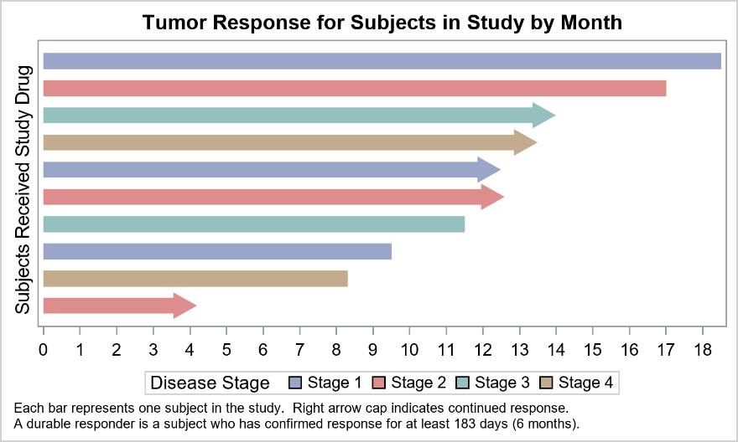
Swimmer Plot
First we represent the duration for each subject by stage in the study
footnote J=l h=0.8 'Each bar..”;
footnote2 J=l h=0.8 'A durable..';
title 'Tumor Response for ..';
proc sgplot data= swimmer dattrmap=attrmap;
highlow y=item low=low high=high / type=bar;
xaxis display=(nolabel) label='Months';
yaxis reverse display=(<options>);
keylegend 'stage';
run;

Slide 20
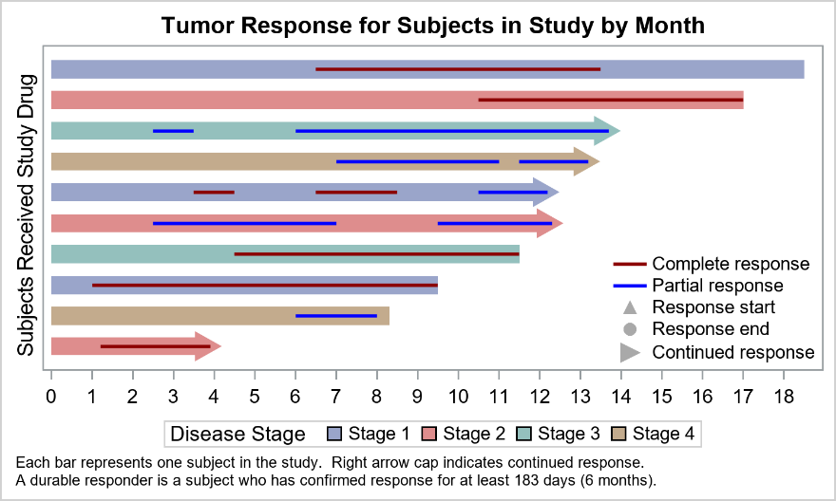
Swimmer Plot
Then we layer the complete or partial response duration.
proc sgplot data= swimmer dattrmap=attrmap;
highlow y=item low=low high=high / type=bar
group=stage name=‘stage’;
highlow y=item low=startline high=endline /
type=line name=‘status’;
scatter y=item x=xmin / name=‘s’ <opts>;
scatter y=item x=xmin / name=‘e’ <opts>;
scatter y=item x=xmin / name=‘a’ <opts>;
xaxis display=(nolabel) label='Months';
yaxis reverse display=(< opts >);
keylegend 'stage';
keylegend 'status' 's' 'e’ ‘a’ / <opts>;
run;
The scatter markers are set to gray color as shown in the legend.
The scatter markers are not drawn in the plot since xmin value is missing.

Slide 21

Swimmer Plot
Finally, we layer the the start, end and durable markers.
proc sgplot data= swimmer dattrmap=attrmap;
highlow y=item low=low high=high / type=bar group=stage name=‘stage’;
highlow y=item low=startline high=endline / type=line name=‘status’;
scatter y=item x=xmin / name=‘s’ <opts>;
scatter y=item x=xmin / name=‘e’ <opts>;
scatter y=item x=xmin / name=‘a’ <opts>;
scatter y=item x=durable / name=‘d’ <opts>;
scatter y=item x=start / name=‘s’ <opts>;
scatter y=item x=end / name=‘e’ <opts>;
xaxis display=(nolabel) label='Months';
yaxis reverse display=(< opts >);
keylegend 'stage';
keylegend 'status' 's' 'e' 'd’ ‘a’ / <opts>;
run;
We overdraw the start and end values markers.
We add the “durable responder” and information.

Slide 22
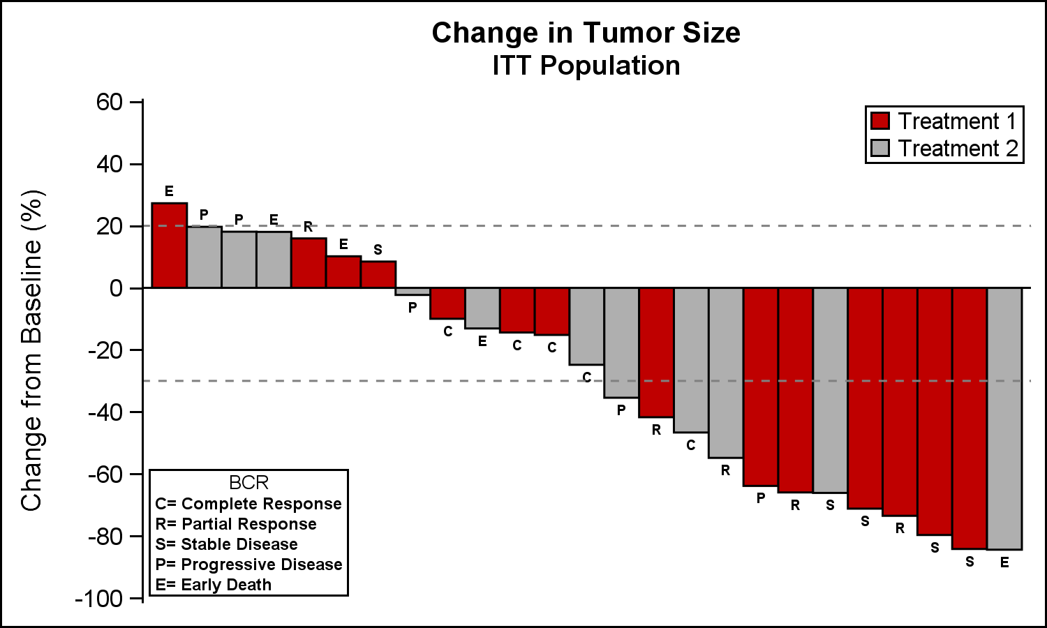
Waterfall Chart
A waterfall chart is commonly used in the Oncology domain to track the change in tumor size for subjects in a study by treatment.
This plot displays the change in tumor size for each patient in the study as a bar classified by treatment, sorted by percent change.
Let us see how it is built.

Slide 23

Waterfall Chart
A waterfall chart is commonly used in the Oncology domain to track the change in tumor size for subjects in a study by treatment.
proc sgplot data=TumorSize noborder;
styleattrs datacolors=(cxbf0000
cx4f4f4f);
vbar cid / response=change
group=group;
refline 20 -30;
xaxis display=none;
yaxis values=(60 to -100 by -20);
inset "C= Complete Response"
"R= Partial Response“ ...
position=bottomleft border;
keylegend / location=inside across=1
border;
run;

Slide 24
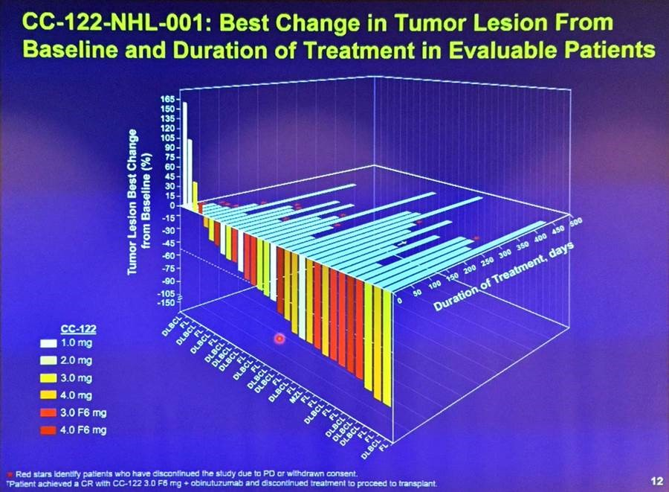
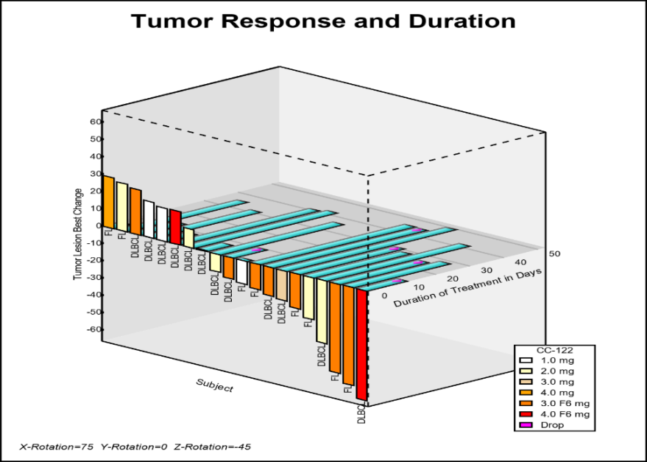
3D Waterfall Chart
Recently, there has been some interest in the clinical community to include treatment duration and other information with a Waterfall graph.
This 3D graph was presented by E Castanon Alvarez et. al. in "3D waterfall plots: a better graphical representation of tumor response in oncology" Annals of Oncology, Volume 28, Issue 3, 1 March 2017.

Slide 25

3D Waterfall Chart
While this 3D representation has some issues, sometimes one has to be able to make one just to present an alternative.
You can create this 3D graph using a macro.
The macro takes tumor and duration data and creates a 3D model.
It then transforms the model from 3D to 2D using an Orthogonal projection.
Then, the graph is displayed using SGPLOT.
The macro is shared in a Graphically Speaking Blog article.

Slide 26

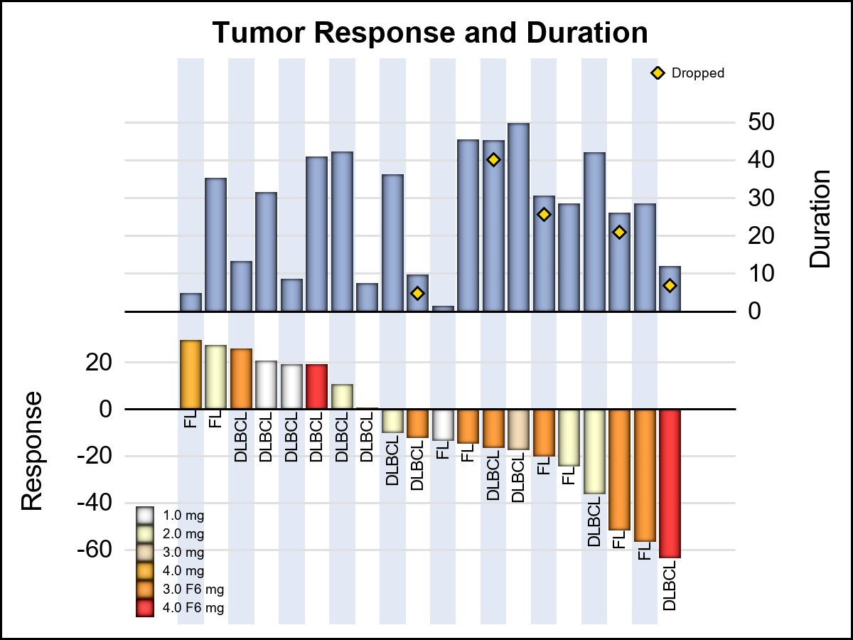
Alternative to 3D Waterfall Chart
3D Graph
2D Graph of same data

Slide 27
Swimmer+Waterfall Chart
proc sgplot data=tumorsorted noautolegend
dattrmap=attrmap;
styleattrs axisextent=data;
vbarparm category=j response=duration / y2axis;
vbarparm category=j response=response / group=drug
dataskin=pressed name='r' attrid=Resp;
scatter x=j y=dropped / y2axis name='c';
text x=j y=codeloc text=code / rotate=90;
yaxis offsetmax=0.5 labelpos=datacenter grid;
y2axis offsetmin=0.55 labelpos=datacenter grid’;
xaxis display=none colorbands=odd;
keylegend 'r' / position=bottomleft location=inside
across=1 valueattrs=(size=4) noborder;
keylegend 'c' / position=topright location=inside
valueattrs=(size=4) noborder;
run;

Slide 28
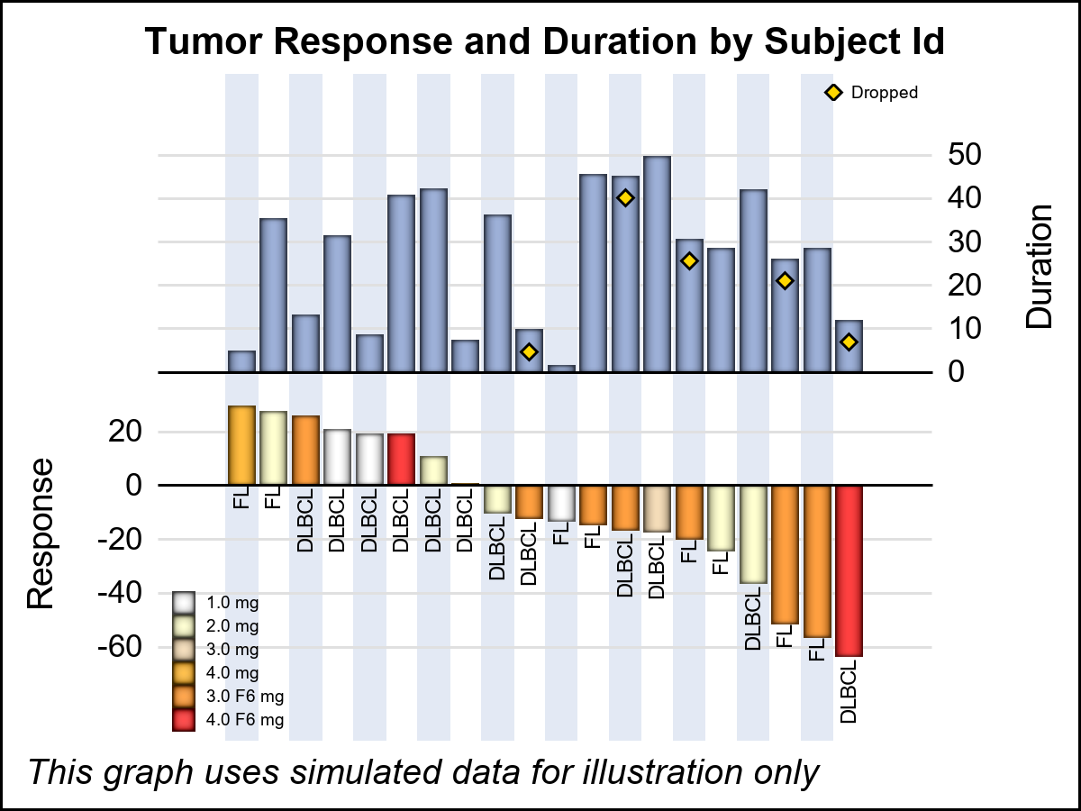
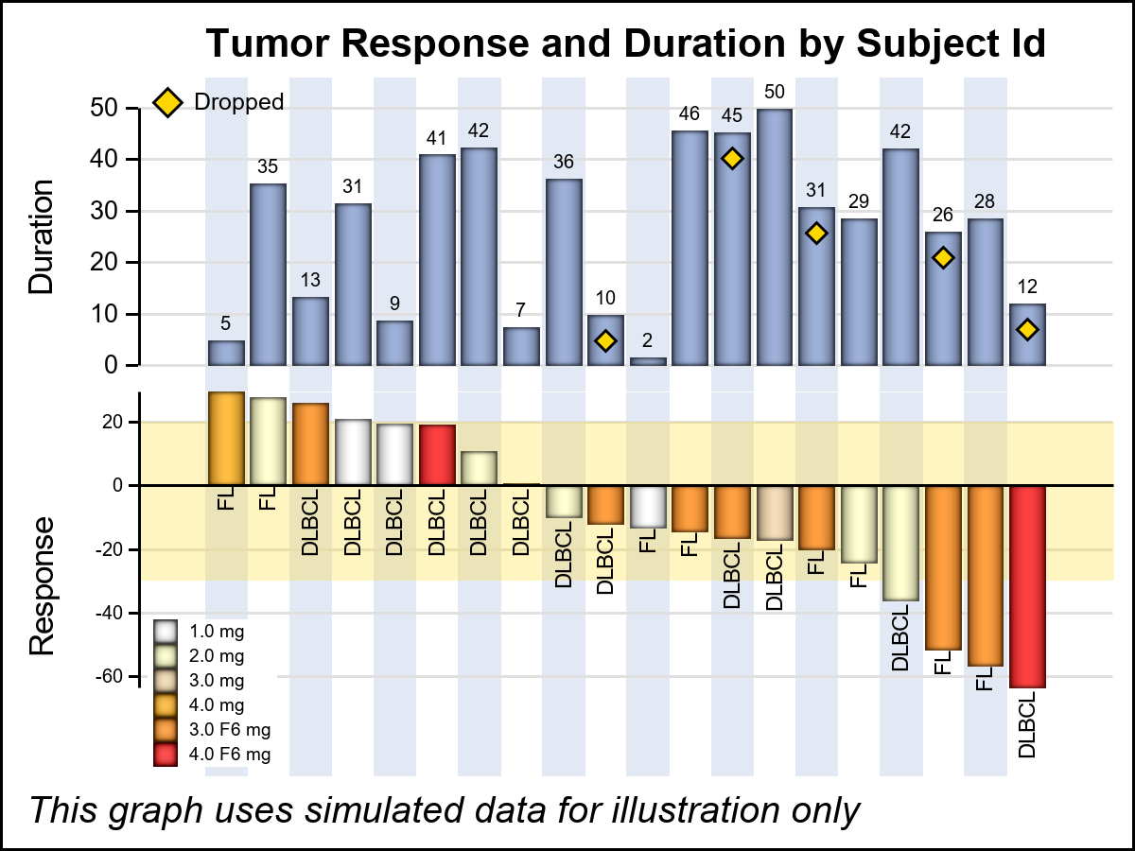
Swimmer+Waterfall Chart
SGPLOT
GTL
Note the Duration axis is on the right
Note both y-axes are on the left

Slide 29
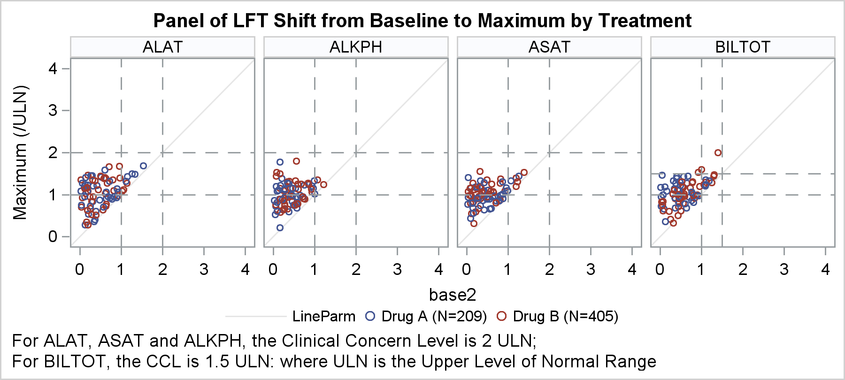
Panel of LFT Shift from Baseline
This graph displays the LFT shifts from baseline to maximum by lab test.
This graph is paneled by the lab test.
Four cells are automatically produced using test as the panel variable.
Maximum by baseline values are plotted with clinical levels of concern and reference line.
Let us see how it is built.

Slide 30
Panel of LFT Shift from Baseline
Clinical concern levels are customized by test.
title "Panel of LFT Shift ...”;
footnote1 j=l "For ALAT, ASAT ...”;
footnote2 j=l "For BILTOT, ...”;
proc sgpanel data=LFTShiftNormRef;
panelby Test / layout=panel columns=4
spacing=10 novarname;
scatter x=base y=max / group=drug;
refline ref / axis=Y
lineattrs=(pattern=dash);
refline ref / axis=X
lineattrs=(pattern=dash);
rowaxis integer min=0 max=4;
colaxis integer min=0 max=4;
keylegend / title="" noborder;
run;

Slide 31
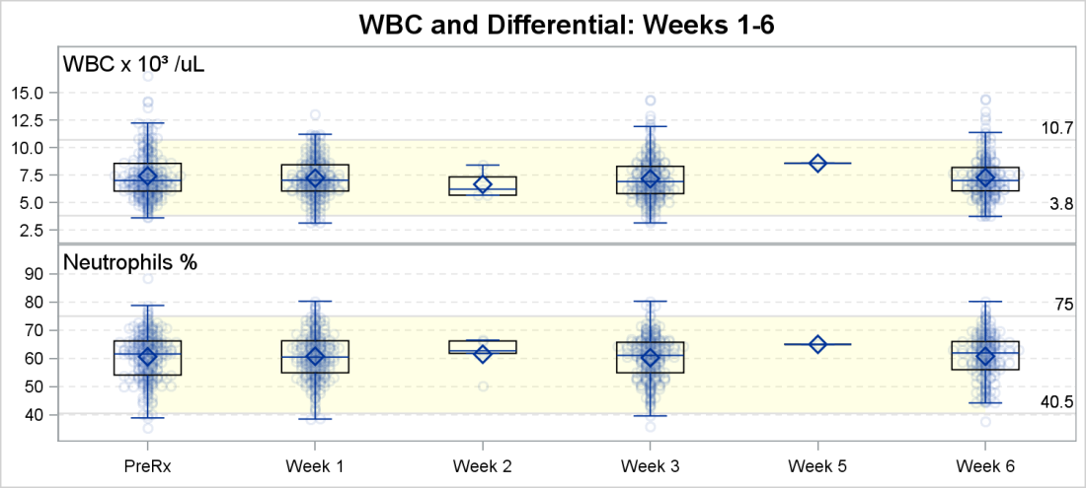
Labs Panel by Test
This graph shows the lab results by test.
We use the SGPANEL procedure with PANELBY=test.
Each test has varying range of response values, so the y axis ranges are not uniform.
Each cell displays a Box Plot of the values by visit with overlay of all the values.
Each cell has its own clinical concern levels.
Let us see how it is built.

Slide 32
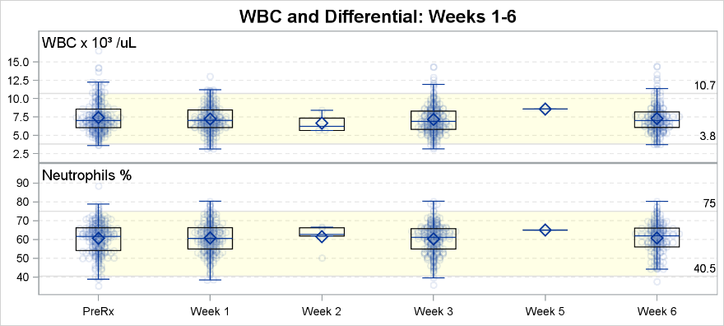
Labs Panel by Test
Clinical concern levels are customized by test.
title 'WBC and Differential: Weeks 1-6';
proc sgpanel data=labs2 noautolegend;
panelby line /onepanel uniscale=column
layout=rowlattice noheader;
band x=visitnum lower=numlow upper=numhi /
transparency=0.9 fillattrs=(color=yellow);
refline numlow / label noclip <options>;
refline numhi / label noclip <options>;
scatter x=visitnum y=result / jitter;
vbox result / category=visitnum <options>;
inset label / position=topleft nolabel;
rowaxis display=(nolabel) offsetmax=0.15 grid;
colaxis display=(nolabel) valueattrs=(size=7);
run;

Slide 33
In Conclusion
SAS 9.4 release of ODS Graphics makes it easier to create clinical graphs.
You can use the SGPLOT procedure for single cell graphs.
You can use the SGPANEL procedure for class panels.
You can use GTL for more complex layouts.

Slide 34
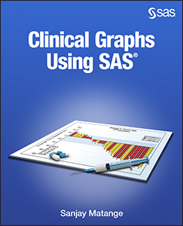
Resources
  Examples presented in this paper are from the book:
  “Clinical Graphs Using SAS”

Slide 35
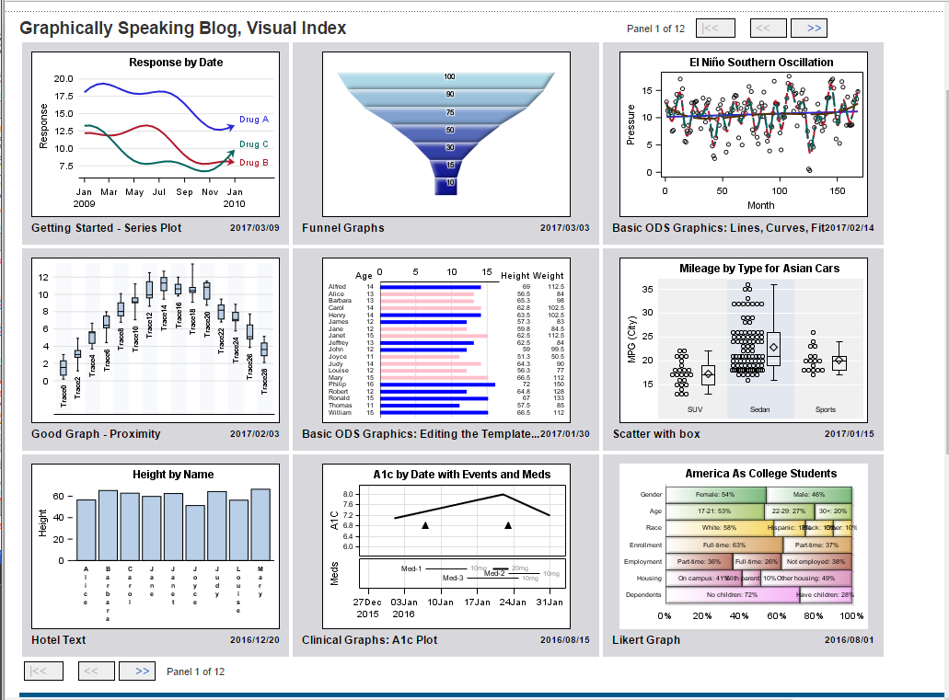

Resources
  Graph Focus Area Page on Support.sas.com.
  Graphically Speaking Blog at: http://blogs.sas.com/content/graphicallyspeaking/

Slide 36
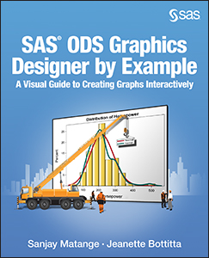
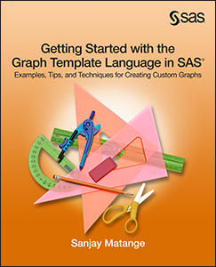

More SAS Press Books on Graphics

